Slide 1

Java Script ES6
Web Development
Certification Training
Copyright © 203 Xebia Group. All rights reserved. release 1.0.0

Slide 2

MODULE TOPICS
JavaScript Arrow Function
JavaScript Default Parameters
JavaScript Template Literals
JavaScript Spread Operator
JavaScript Map
JavaScript Set
Destructuring Assignment
JavaScript Classes

Slide 3
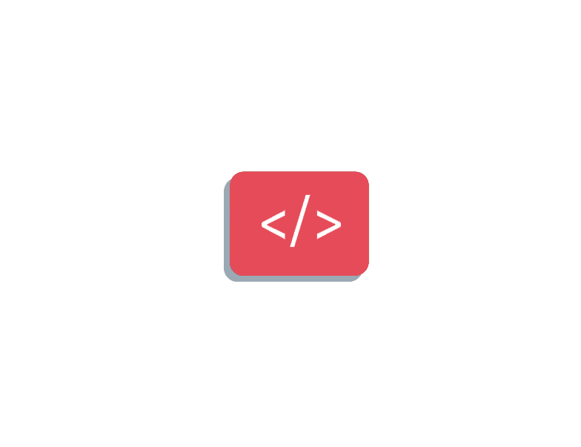

WHAT IS Javascript es6?
JavaScript ES6 (also known as ECMAScript 2015 or ECMAScript 6) is the newer version of JavaScript that was introduced in 2015.
ECMAScript is the standard that JavaScript programming language uses. ECMAScript provides the specification on how JavaScript programming language should work.
This tutorial provides a brief summary of commonly used features of ES6 so that you can start quickly in ES6

Slide 4
ARROW FUNCTION
Arrow function is one of the features introduced in the ES6 version of JavaScript. It allows you to create functions in a cleaner way compared to regular functions. For example,
This function
// function expression
let x = function(x, y) {
return x * y;
}
can be written as
// using arrow functions
let x = (x, y) => x * y;

Slide 5
JavaScript Default Parameters
The concept of default parameters is a new feature introduced in the ES6 version of JavaScript. This allows us to give default values to function parameters. Let's take an example,
function sum(x = 3, y = 5) {
// return sum return x + y;
} console.log(sum(5, 15));
// 20 console.log(sum(7));
// 12 console.log(sum());
// 8
In the above example, the default value of x is 3 and the default value of y is 5.
sum(5, 15) - When both arguments are passed, x takes 5 and y takes 15.
sum(7) - When 7 is passed to the sum() function, x takes 7 and y takes default value 5.
sum() - When no argument is passed to the sum() function, x takes default value 3 and y takes default value 5.

Slide 6
JavaScript Template Literals (Template Strings)
Template literals (template strings) allow you to use strings or embedded expressions in the form of a string. They are enclosed in backticks ``. For example,
const name = 'Jack'; console.log(`Hello ${name}!`); // Hello Jack!

Slide 7
JavaScript Spread Operator
The spread operator is a new addition to the features available in the JavaScript ES6 version.
Spread Operator
The spread operator ... is used to expand or spread an iterable or an array. For example,
const arrValue = ['My', 'name', 'is', 'Jack'];
console.log(arrValue); // ["My", "name", "is", "Jack"]
console.log(...arrValue); // My name is Jack
Run Code
In this case, the code:
console.log(...arrValue)
is equivalent to:
console.log('My', 'name', 'is', 'Jack');

Slide 8
JavaScript Map
The JavaScript ES6 has introduced two new data structures, i.e Map and WeakMap.
Map is similar to objects in JavaScript that allows us to store elements in a key/value pair.
The elements in a Map are inserted in an insertion order. However, unlike an object, a map can contain objects, functions and other data types as key.
Create JavaScript Map
To create a Map, we use the new Map() constructor. For example,
// create a Map const map1 = new Map(); // an empty map console.log(map1); // Map {}
Insert Item to Map
After you create a map, you can use the set() method to insert elements to it. For example,
// create a set let map1 = new Map(); // insert key-value pair map1.set('info', {name: 'Jack', age: 26}); console.log(map1); // Map {"info" => {name: "Jack", age: 26}}

Slide 9
JavaScript Set and WeakSet
The JavaScript ES6 has introduced two new data structures, i.e Set and WeakSet.
Set is similar to an array that allows us to store multiple items like numbers, strings, objects, etc. However, unlike an array, a set cannot contain duplicate values.
Create JavaScript Set
To create a Set, you need to use the new Set() constructor. For example,
// create Set const set1 = new Set(); // an empty set console.log(set1); // Set {} // Set with multiple types of value const set2 = new Set([1, 'hello', {count : true}]); console.log(set2); // Set {1, "hello", {count: true}}
When duplicate values are passed to a Set object, the duplicate values are excluded.
// Set with duplicate values const set3 = new Set([1, 1, 2, 2]); console.log(set3); // Set {1, 2}

Slide 10
JavaScript Destructuring
The destructuring assignment introduced in ES6 makes it easy to assign array values and object properties to distinct variables. For example, Before ES6:
// assigning object attributes to variables const person = { name: 'Sara', age: 25, gender: 'female' } let name = person.name; let age = person.age; let gender = person.gender; console.log(name); // Sara console.log(age); // 25 console.log(gender); // female

Slide 11
JavaScript Classes
Classes are one of the features introduced in the ES6 version of JavaScript.
A class is a blueprint for the object. You can create an object from the class.
You can think of the class as a sketch (prototype) of a house. It contains all the details about the floors, doors, windows, etc. Based on these descriptions, you build the house. House is the object.
Since many houses can be made from the same description, we can create many objects from a class.
Creating JavaScript Class
JavaScript class is similar to the Javascript constructor function, and it is merely a syntactic sugar.
The constructor function is defined as:
// constructor function function Person () { this.name = 'John', this.age = 23 } // create an object const person1 = new Person();

Slide 12
ARROW FUNCTION
Arrow function is one of the features introduced in the ES6 version of JavaScript. It allows you to create functions in a cleaner way compared to regular functions. For example,
This function
// function expression
let x = function(x, y) {
return x * y;
}
can be written as
// using arrow functions
let x = (x, y) => x * y;

Slide 13
ARROW FUNCTION
Arrow function is one of the features introduced in the ES6 version of JavaScript. It allows you to create functions in a cleaner way compared to regular functions. For example,
This function
// function expression
let x = function(x, y) {
return x * y;
}
can be written as
// using arrow functions
let x = (x, y) => x * y;

Slide 14
ARROW FUNCTION
Arrow function is one of the features introduced in the ES6 version of JavaScript. It allows you to create functions in a cleaner way compared to regular functions. For example,
This function
// function expression
let x = function(x, y) {
return x * y;
}
can be written as
// using arrow functions
let x = (x, y) => x * y;

Slide 15
ARROW FUNCTION
Arrow function is one of the features introduced in the ES6 version of JavaScript. It allows you to create functions in a cleaner way compared to regular functions. For example,
This function
// function expression
let x = function(x, y) {
return x * y;
}
can be written as
// using arrow functions
let x = (x, y) => x * y;

Slide 16
ARROW FUNCTION
Arrow function is one of the features introduced in the ES6 version of JavaScript. It allows you to create functions in a cleaner way compared to regular functions. For example,
This function
// function expression
let x = function(x, y) {
return x * y;
}
can be written as
// using arrow functions
let x = (x, y) => x * y;

Slide 17
ARROW FUNCTION
Arrow function is one of the features introduced in the ES6 version of JavaScript. It allows you to create functions in a cleaner way compared to regular functions. For example,
This function
// function expression
let x = function(x, y) {
return x * y;
}
can be written as
// using arrow functions
let x = (x, y) => x * y;

